Slide 1

Initiative 732 revenue-neutral carbon tax ballot measure
Mike Massa
www.CarbonWA.org

Slide 2
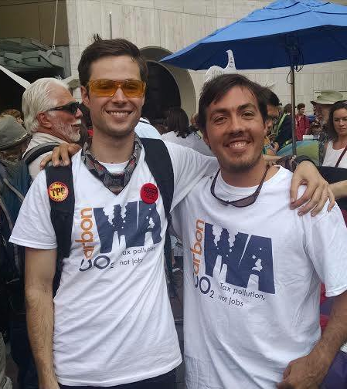
Who We Are
Who We Are
Grassroots group of
  Scientists
  Economists
  Business owners
  Former elected officials
  Students
  Concerned citizens
  Non-partisan
  We work in living rooms; not board rooms

Slide 3
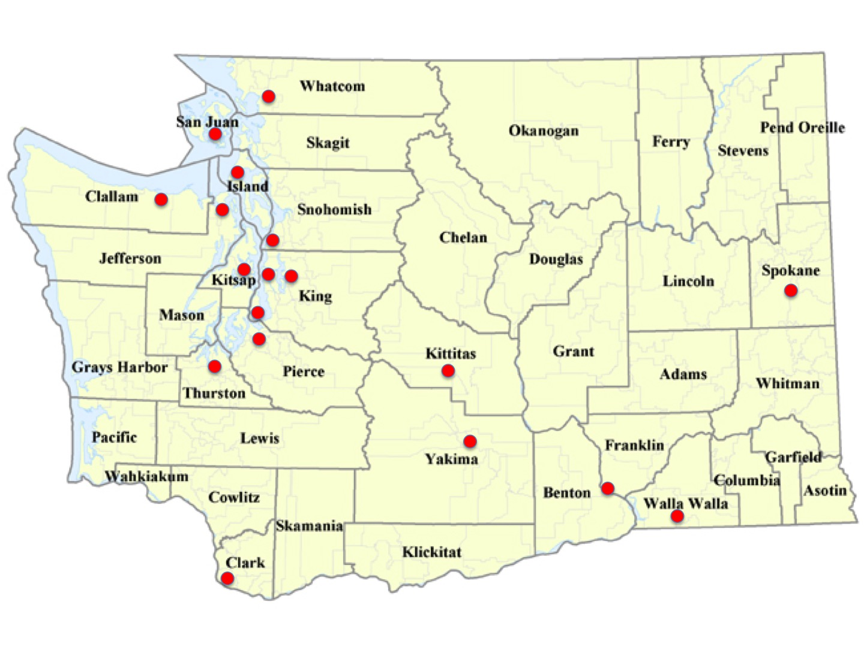
30+ Chapters
Hundreds of Active Volunteers

Slide 4
Policy Design Goals
Effective at reducing emissions
  Meaningful price signal to all fossil fuel consumers
Fair in who pays
  Protect low & middle income households
  Protect small & trade-exposed businesses
Supports economic growth
Politically viable & durable in divided state
  Draw support from both sides of aisle
  Model for other states & Congress

Slide 5
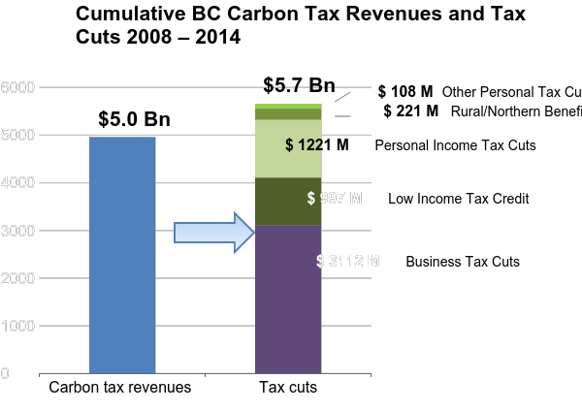
Source: BC Budgets 2008-2013

Slide 6
Starting price:
CA$10/ton
Canada
B.C.
Price frozen at
CA$30/ton
Source: CANSIM 134-0004, 051-0001

Slide 7
Canada
B.C.
Source: CANSIM 384-0038, 051-0001

Slide 8
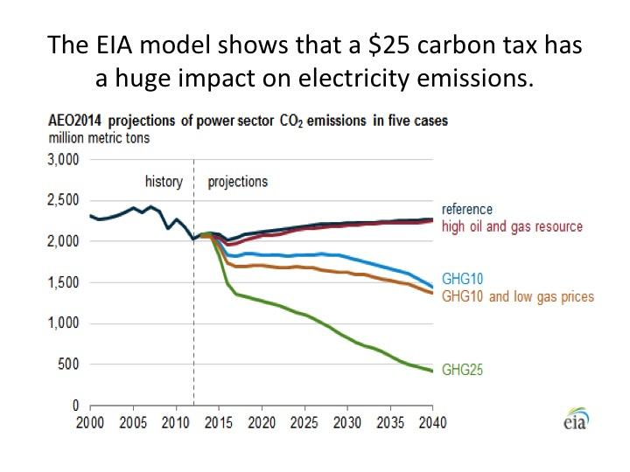

Slide 9
Our Proposal
What’s the plan?
$25/ton tax on fossil fuel carbon emissions
Reduce sales tax 1%
Eliminate B&O tax on manufacturers
Fund and increase the Working Families Rebate
What does it do?
Reduce climate pollution
Preserve household & business spending power
Preserve manufacturing jobs
Make our regressive tax system more fair

Slide 10
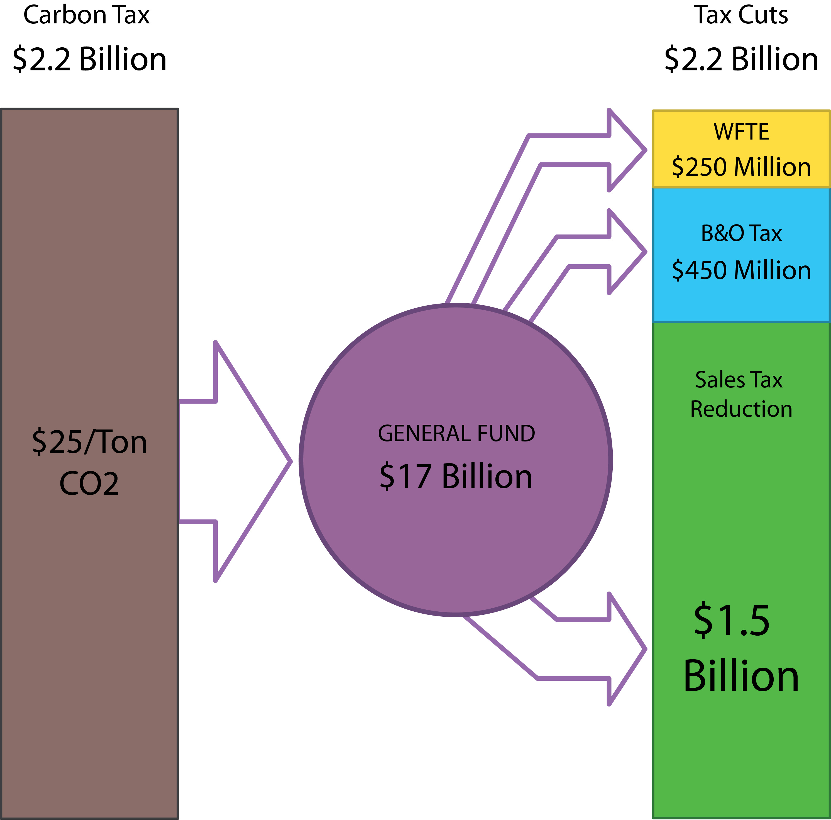
Revenue Neutral Tax Swap
Tax Rebate for Working Families
Tax Covers
Fossil Fuels Consumed Within State
Imported Electricity
Cut Taxes on Manufacturers
Cut Sales Tax Rate One Point
(6.5% → 5.5%)
Slower
Phase-In
Ag Diesel
Non-Profit Transit
Maintain revenue neutrality by slowly raising carbon tax rate over time

Slide 11
Why Rebate Carbon Revenues?
Energy taxes are inherently regressive
Disproportionately burden low and middle income households
Manufacturers have to compete out of state
“Leakage” = lost jobs and same (or worse) global emissions
Compensate while still incenting emissions reductions
Tax increases are an economic drag
Need strong carbon price to incent emissions reductions
Tax Increases are HARD politically
Voters have approved only 3 statewide tax increases in last 20 years
Voted 5 times to repeal taxes and 6 times to make it harder to raise them
Bipartisan Appeal
Right: Bill Finkbeiner, Steve Litzow, George Shultz, Bloomberg View
Left: Clallam Co Dems, Mike Doherty, Jim McDermott, Joe Fitzgibbon

Slide 12
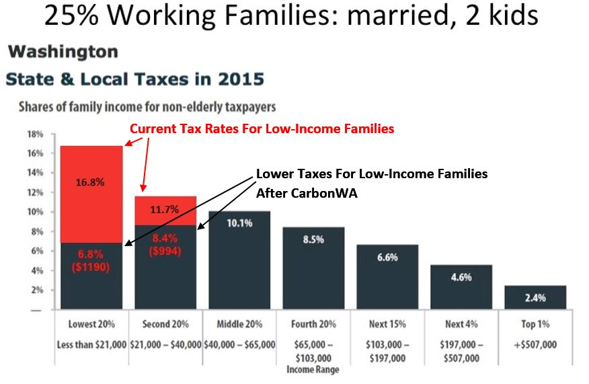
Based on Institute on Taxation and Economic Policy, Who Pays? (2015)

Slide 13
State Fiscal Impact
OFM Est: -$797M over 6 years (local rev +$156M)
We are confident will be revenue-neutral in practice
OFM forecast based on 3 faulty assumptions:
  Did not tax exported electricity ($375m – 6 yrs)
  Wrong tax rate for unspecified electricity ($323m – 6 yrs)
  2x payout of Working Families Rebate ($263m – 1st yr)
Even if OFM correct on revenue, Legislature can fix with majority vote after 18 months
  Projected 18 month deficit: -$122M
  Proper implementation of WFR erases deficit

Slide 14
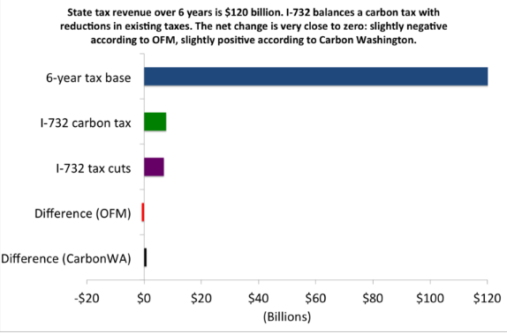
Fiscal Impact in Perspective
Perspective: Recent state revenue forecast shifted $424M over 2 years (1.1%)
Projected I-732 deficit $797M over 6 years (0.66%)
State estimates climate impacts will cost $3.8B per year by 2020
I-732 provides $1 billion to low-income families over 4 years!

Slide 15
Clallam County Impact
Avg WA family:
  Pay $200-300 more for energy (utilities, transportation)
  Save $200-$300 on everything else (sales tax cut)
But Clallam PUD fuel mix is ~93% non-fossil
  Carbon tax = ~$0.0018 kWh (~2/10ths of penny)
  Based on 2010-2014 avg fuel mix & $25/ton tax
~$40/yr cost for avg 2,000sqft home w/ electric heat
~$226 sales tax savings for household earning Clallam family median ($58,100)
  Estimate from UW Carbon Tax Swap Calculator
Up to $1500/yr rebate to low income families

Slide 16
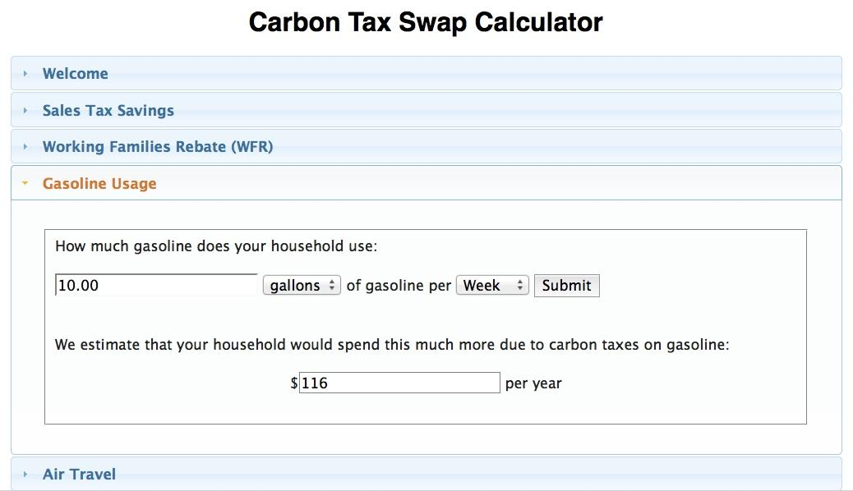
carbon.cs.washington.edu

Slide 17
Clallam PUD Miscalculations
Overestimated carbon tax cost by ~18%
  Used wrong tax rate for unspecified power
Ignored value of sales tax cut & WFTR
Ignored risks/costs of climate change
  Less hydropower. More wildfires, drought, sea level rise
Risk of “pancaking” regulations overblown
  Taxing carbon is one way to comply with federal Clean Power Plan
  Draft state Clean Air Rule exempts electric sector (defers to CPP)
  More renewables help PUD meet RPS mandate (I-937)
More EVs & electric heating help maintain power demand lost to conservation & increased efficiency

Slide 18
I-732 Supporters
Scientists: James Hansen, Richard Gammon, Cliff Mass
Economists: 44 from Washington
Media: Olympian, Bloomberg View, Seattle Business, Whidbey News-Times
R Politicians: Bill Finkbeiner, Steve Litzow, George Shultz
D Politicians: Mike Doherty, Jim McDermott, 11 state legislators, 7 county & city leaders, 2 state legislature candidates
D Party Orgs: Clallam Co Dems & 11 other Dem Party orgs
Climate groups: Olympic, Bainbridge, Cascadia, Oregon, Citizens Climate Lobby
Faith groups: UU Voices, Interfaith Works, Climate Action Ministry
Many business, academic, & civic leaders

Slide 19
Why Support I-732?
Great step forward with a proven policy
Puts a strong price on carbon pollution
Improves fairness of state tax system
Preserves manufacturing jobs
Easily explained & broadly appealing to voters
Creates model for other states & Congress to follow
2016 is a can’t miss opportunity
The climate won’t wait!

Slide 20
How You Can Help
SPREAD THE WORD within your networks
EDUCATE friends, colleagues, public officials
ENDORSE the measure (biz/org/govt leaders)
DONATE to campaign
VOLUNTEER your time and skills
WRITE op-eds & letters to editor
CONNECT the campaign to potential:
  Volunteers, endorsers, funders, supportive orgs

Slide 21
Appendix

Slide 22
Carbon Tax & Energy Data
Effect of $25/ton carbon tax on energy prices
  Gasoline: $0.22/gallon
  Diesel: $0.25/gallon
  Natural gas: $0.13/therm
  Clallam PUD electricity: $0.002/kWh
  State avg electricity: $0.007/kWh
WA State electricity mix (avg for 2010-2015)
  66.3% Non-fossil
  15.1% Unspecified (open market purchases)
  10.4% Coal
  8.2% Natural Gas
  < 0.1% Petroleum

Slide 23
North Olympic Climate Impacts
Less snowpack → lower river flow & longer dry season
Shifts in the timing and type of precipitation
  More rain on snow events
  More high stream flows → scour rivers & flood lowlands
Higher temps → more wildfires, decreased soil moisture, stressed forests & fish
More sea level rise → coastal flooding & shoreline erosion
More corrosive (acidic) ocean waters
  Slower growth & higher mortality for crab, mussels, etc

